Slide 1
Proto File Basics
Programming Palli

Slide 2
Agenda
What is proto file.
Define Service
Protobuf message.
Naming Conventions.

Slide 3
Proto File
gRPC uses Protobuf as its Interface Definition Language (IDL).
Protobuf IDL is a language neutral format for specifying the messages sent and received by gRPC services.
Protobuf messages are defined in .proto files.

Slide 4
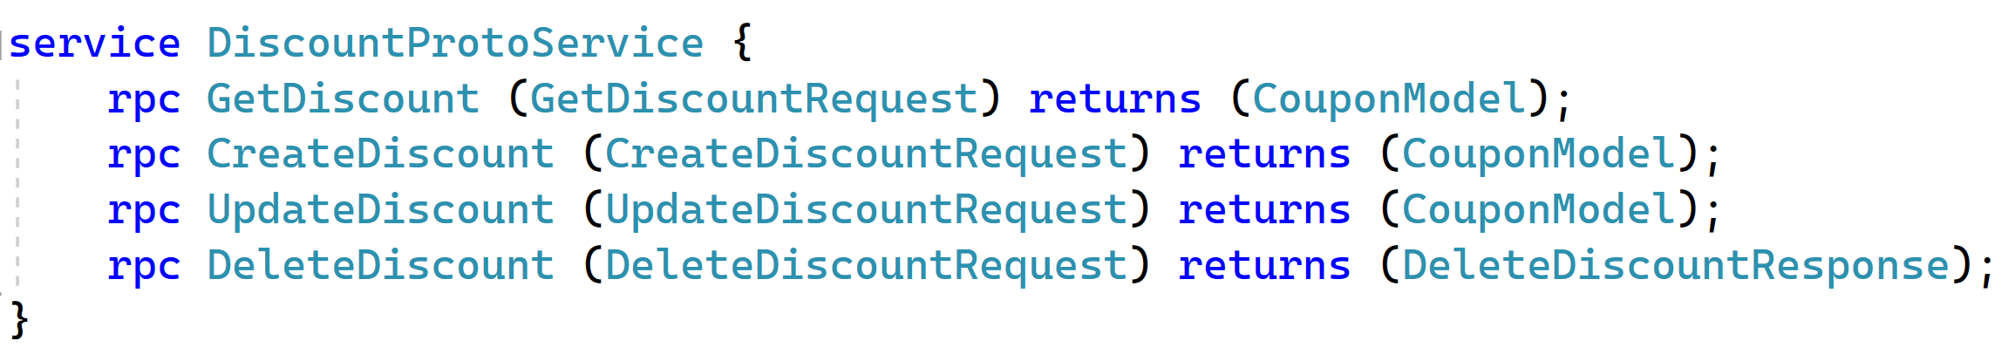
Define Service
you can define an RPC service interface in a .proto file and the protocol buffer compiler will generate service interface code and stubs in your chosen language.

Slide 5
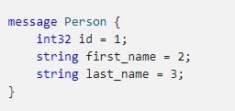
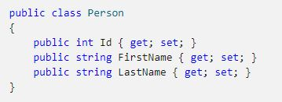
Protobuf Messages
Messages are the main data transfer object in Protobuf. They are conceptually similar to .NET classes.
Protobuf File
.NET Class

Slide 6
Naming Conventions
Files should be named lower_snake_case.proto.
Use CamelCase (with an initial capital) for message and Service names – for example, DiscountRequest, CreateDiscount.
Use underscore_separated_names for field names – for example, product_name.
The " = 1", " = 2" markers on each element identify the unique “tag” that field uses in the binary encoding.

Slide 7
Thank You
Please subscribe

